Slide 1


Microplastics
Hackathon - Final Presentation

Slide 2





Presentation Outline
Problem Formulation
Breast Cancer Trends
Results Analysis
Our
Recommendations
Further Work and
Call to Action
Notes:
This is our presentation outline for today. Firstly, we would be touching on Problem Formulation, how we came to finding about Microplastics emission and their impacts on human health. Next, we would be diving into one of the consequences of microplastics in our bloodstream, which is increased risks in Breast Cancer - In particular, we would be analyzing the Breast Cancer trends in Singapore in order for us to understand why this is a cause for concern in the first place.
Thirdly, we would be analyzing the results of our regression model that we have ran on our datasets gathered, and making sense of the results.
Fourthly, we would be presenting our recommendations based on the results seen from our model.
Last but not least, our presentation will cover any further work that could possibly be done to the problem of microplastics, as well as the call to action for AON.

Slide 3









How does Microplastics become a problem to us?
Found in oceans
Found in marine animals
Effects on humans
Found in oceans
Found in marine animals
Effects on humans
From various sources
Small marine animals ingest MP by accident, mistaking it for food
Found in human feces and blood
Studies have found that it impacts humans
Problem
Formulation
Breast Cancer Trends
Results Analysis
Our Recommendations
Further Work and Call to Action
Notes:
Before we dive in to our presentation, we would like to explain how microplastics become a problem to us.
Microplastics end up in the oceans from various sources such as synthetic textiles, city dust, or personal care products. Microplastics can be formed from the simple wave action, wind abrasion, ultraviolet radiation from sunlight, or be intentionally created to be used in human activities or products, such as exfoliating cleansers with microbeads.
These microplastics then get washed up into the ocean through wind or rain run off, and get ingested by small marine animals such as planktons, who think that the microplastics are their food source such as algae. These planktons get eaten by small fish, which get eaten by bigger fish, and this is how microplastics travel up the food chain to reach us in humans.
As all of us know by know, we eat a credit card’s worth of microplastics each week, and this is proven as it is found in our feces, and most recently, found in our blood. This is indeed alarming, and studies have found that it may impact human health in various ways, including causing child development, fertility problems and cancer. We’ve taken a look at the relationship between cancer rates and microplastic emissions, and found that there is indeed a positive correlation.
<< Click on the box around “Studies have found that it impacts humans!” to go to appendix slide to show the graph >>
We’ve decided to focus on breast cancer for our report as a few research studies have pointed to microplastics having a greater effect on hormonal cancers such as breast cancers. I will now go on to explain why this is so.
<< Click on the box that points to slide 8 to explain how microplastic causes breast cancer >>
Now, we would be going on to talk about how microplastics can cause breast cancer.
Microplastics could cause oxidative stress by releasing oxidising chemicals (such as metals) adsorbed to their surface and reactive oxygen radicals. Oxidative stress can damage cells, proteins and DNA, which contributes to ageing.
As repeated cell death ensues, more cell division has to occur, and hence increasing the risk of dna mutation and cancer.
Microplastics also often contain a mixture of EDCs, which are endocrine disrupting chemicals. How EDCs work is by being shaped like the natural hormones, and attaching to the hormone receptor, and hence either blocking the natural hormone from being able to latch on to the receptor, or triggering the hormone receptor when it is not supposed to. Recent science has found that EDCs are associated with various diseases and conditions, such as hormonal cancers such as breast cancer, as the EDCs will induce adverse effects in the normal mammary development.

Slide 4
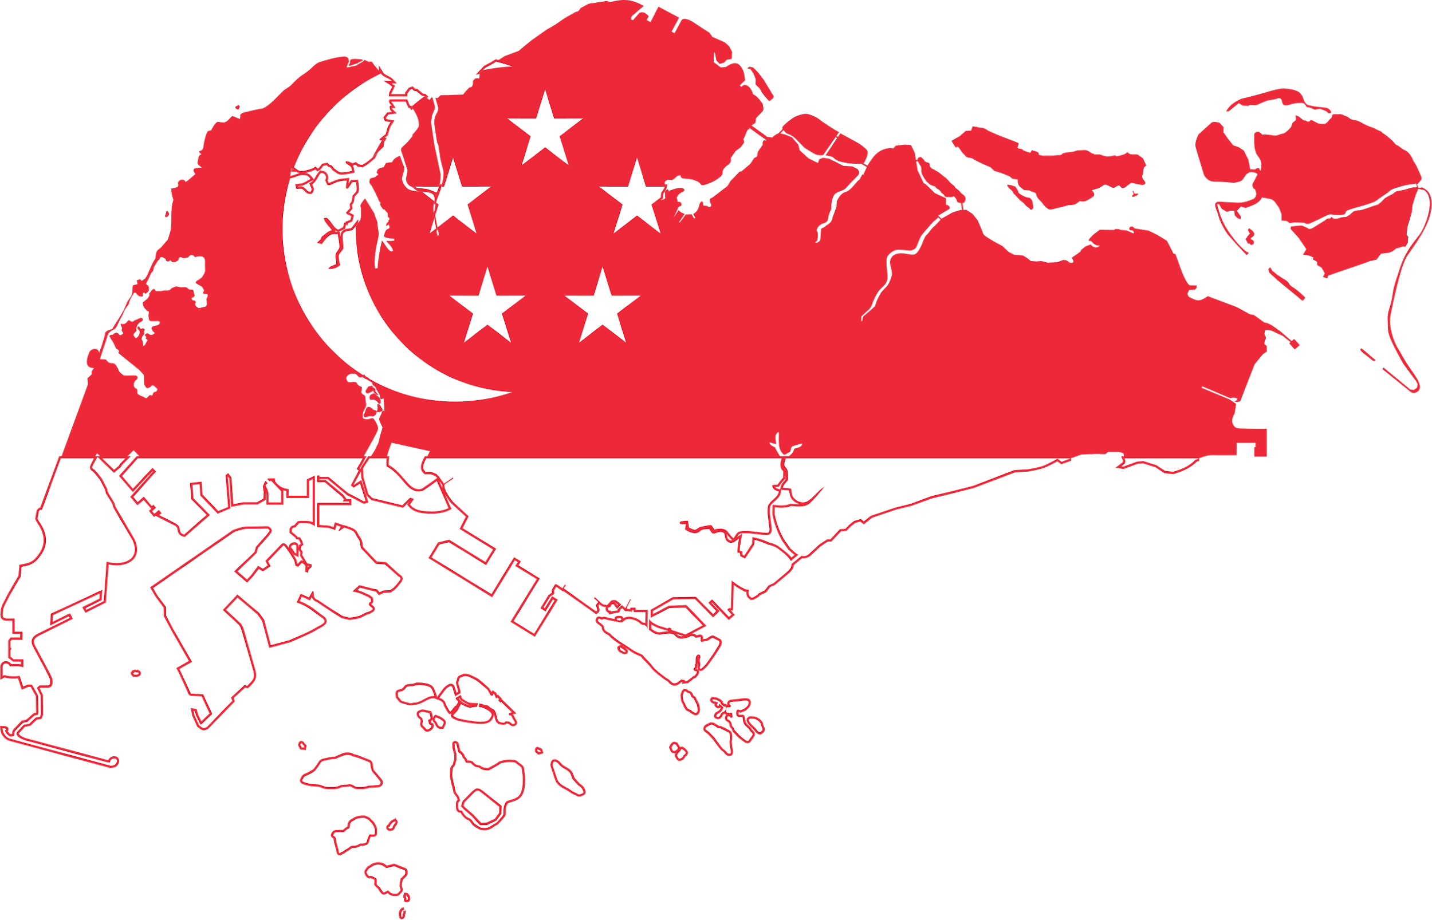
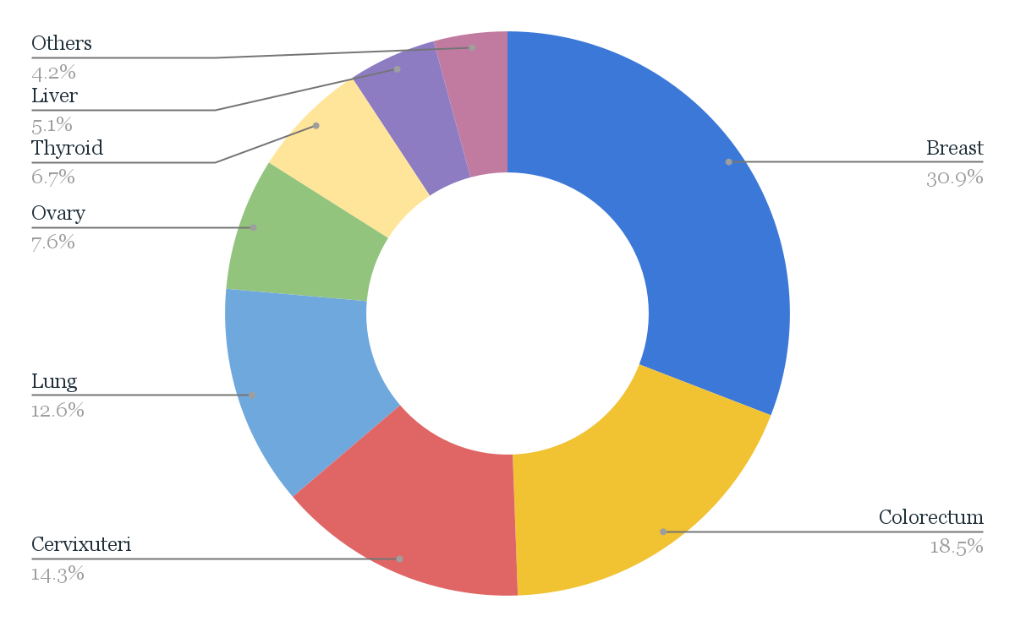

Breast Cancer Incidence in Singapore
51,876
35,431
22,790
Female ♀
2000
14,184
Women diagnosed with breast cancer each year
400
(Cancer Today, 2020)
Deaths due to breast cancer in females per year
Proportion of Types of Cancer Affecting Females in Singapore (2020)
1 in 16
1973-1982
1983-1992
1993-2002
2003-2012
Total Breast Cancer Incident in Females (1973-2012) and 10-Year Period
Breast Cancer is the most commonly occurring cancer and makes up to 40.9% of all cancer types in Singapore
Woman diagnosed with
breast cancer each year
Problem
Formulation
Breast Cancer Trends
Results Analysis
Our Recommendations
Further Work and Call to Action
Notes:
Breast Cancer is the most commonly diagnosed cancer amongst women in Singapore. Each year, over 2000 women are diagnosed with breast cancer, and over 400 will die from this disease. 1 in 16 women is estimated to be diagnosed with breast cancer each year.
From the graph seen here, you can see that the total breast cancer incidence in Singapore has been increasing tremendously each year. In fact, the figures are very alarming. In the period ending Year 1982, there were a total of 14,184 cases of Breast Cancer. Fast forwarding to the period ending in the Year 2012, there is a whooping 51,876 cases of Breast Cancer. That is more than a 3x increment in the Breast cancer incidence in Singapore, in just a span of 30 years. This easily tells us that Breast Cancer in Singapore is not going anywhere anytime soon, and it is important for us to discover the factors that may be causing a risk for Breast Cancer, one of which includes Microplastic in our bloodstreams.
Lastly, we can see from the chart that Breast Cancer is the most common type of Cancer affecting Females in Singapore, even beating out cancers like Colorectal, Lung and Liver cancers.
In fact, Breast Cancer makes up to 30.9% of all cancer types amongst females in Singapore.

Slide 5








Impact of Microplastics on Breast Cancer
Independent Variables
Dependent Variable
Microplastics Emission (Tonnes)
Mean age at First Childbirth (Years)
Breast Cancer Incidence Rate (%)
Alcohol Consumption (Litres per adult)
Reproductive Lifespan (Years)
Given 1% increase in Microplastic Emission
222
cases
$59 million
Problem
Formulation
Breast Cancer Trends
Results Analysis
Our Recommendations
Further Work and Call to Action
Notes:
After research and finding out that microplastics has the potential to cause a higher risk of getting breast cancer, it is now time for us to perform data analysis and investigate the exact impact through regression analysis.
The predictor variables that we have used in our primary model of regression analysis are as follows: Microplastic Emissions, Alcohol consumption, Age at first childbirth, Reproductive lifespan. Initially, there were a few more predictors than these, such as Body Mass Index and Cigarettes Consumption. However, due to high correlation between these independent variables, which indicates multicollinearity, our stepwise regression model has decided to drop those predictors and only went with the ones seen in this slides.
Our dependent variable that was used in the regression model, is the Breast Cancer Incidence Rate in %.
Following this, our model serves to tell us what a change in microplastic emissions will lead to in Singapore’s context. Our team has decided to went ahead and predict the values for a 1% increase in Microplastics Emission, and here were the results obtained. The figures in our model were more intricate and complex to understand, but in laymen terms, for a 1% increase in Microplastics Emission, the Singapore Government can essentially expect an increase in 222 Breast cancer incidence in Singapore, which will attribute to an increase in $59 Million expenditure in Healthcare.
With these alarming figures, our group is certain that the Singapore Government will be very concerned about the effects of microplastics to the nation. Following these results, here are the recommendations that we intend to present to our stakeholders.

Slide 6
Recommendations
Producer
Single-Use Plastic Tax
Discourage producers in using single use plastic
Implemented in phases to reduce the Financial impact
Changes can be observe once tax imposed. However changes in mindset require time
Considerations
Regressive Tax
Merchant
GST Suspension/Reduction for Fish Imports in Selected Areas
Incentivise the merchants to import seafood from countries with lower level of plastic pollution
creating a new GST suspension/reduction scheme
Considerations
Potential Discriminating Policy
Increase cost of goods
Lower Tax Revenue
Recommendations
Market-Based Policy Instrument
Convenience tax on merchant (Subject to criteria)
Reward merchants → More Rebates, etc.
Collaboration with Supermarket
Potential risk resulting in an incentivised base community
Consumer
Using Science and Education Material to Inform the Public
Campaign on educating people to cut down on exposure to microplastic
Citizen science solution
Considerations
Lack of participants and willing parties
Problem
Formulation
Breast Cancer Trends
Results Analysis
Our Recommendations
Further Work and Call to Action
Notes:
As what everyone says, there will always be a solution to every problem and hence our group has manage to formulated 4 different sets of recommendation for 3 different stakeholders. As for the producer, we are proposing the imposing of single use plastic tax and the rationale behind such recommendation is to discourage producers in using single user plastic on their products. Such tax will be implemented in phases as we foresee a potential financial impact it will have on the manufacturer, thus, by implementing in phase we could then give time to allow manufacturer to reevaluate their business model and reduce the direct financial impact, tax will bring upon. In addition, tax impose will result in the immediate decrease in plastic waste volume as people will cut down on such product as price will inherently increase. However, the changes in mindset will take time thus tax brought upon both short and long term effect. One consideration we need to look up for is that tax will be regressive in which it will have some financial impact on certain individual. Hence we need to ensure that it is calibrated in such a way that it does not significantly impact the standard quality of life and incur additional financial stress on the Singapore residents.
The next 2 recommendation will be primary target at Merchant. The first of which GST Suspension/Reduction for fish imports in selected areas. We found out that a major source of microplastic is from seafood and we Singaporean love to consume seafood and form a major component on our diet. As such, to reduce the consumption of microplastics by Singaporeans, the Singapore government can incentivise the merchants to import seafood from countries that produce and use lower levels of plastic in relation to other countries. Example of such countries are Norway, Chile, Canada, Ecuador and Vietnam who are major exporters of seafood as well as produce lower levels of plastics in comparison to other countries.As a result, the seafood imported from such countries will have lower levels of microplastic quantity in them.
A new GST suspension/reduction scheme can also be introduce to allow merchants to import seafood from countries with lower amounts of microplastics. Merchants would be incentivised to do so as this leads to lower cost.
The second recommendation for merchant would be market based policy instrument such as convenience tax on merchants who default to using disposable containers even when they have in house seating, unless they have a reasonable recycling process. Likewise, we can also incentivise merchants which are zero waste by providing rebates. Lastly, we can collaborate with supermarket to allow consumers to purchase raw meat in reusable containers. Some of the consideration are that foreign nation might see it as potential discriminating policy, it might increase cost of goods sold as seafood are import far from Singapore and if the policy is effective, there will be lower tax revenue.
As for the second consideration, there could be a potential risk resulting in an incentivise base community where it is the extrinsic motivator that drive this action.
Last moving on to consumer, we can use science and education material to inform the public. 2 such initiative can be through campaign and citizen science solution. As for campaign, it can help educate people to cut down on exposure to microplastic such as avoid reheating of food in a plastic container. For the second initiative, Citizen science solution. It can help provide a more hands on approach where we will allow the public to collect samples of microplastic and educate them the importance of such initiative. However, the consideration that we need to take into account is that there might lack of participant or willing parties in which we believe there need to be a contingency plan for such event.

Slide 7








Further Work
Call to Action
222
cases
Breast Cancer Incidence
Secondary Research
Primary Research
?
Birth Rate
Problem
Formulation
Breast Cancer Trends
Results Analysis
Our Recommendations
Further Work and Call to Action
Notes:
After having investigate the impact of microplastics on breast cancer incidence, we managed to map this impact onto the healthcare expenditure figures in Singapore. This is an external/monetary feature that the government will be concerned with. However, our team believes that not only should we look at should external motivations, but also the intrinsic motivations for the government to buy into our recommendations.
In particular, we believe that the rise in breast cancer incidence may very well have an impact in the birth rates in Singapore. It is not a far leap to say that having a society become increasingly prone to getting cancer will naturally deter and expel them from the idea of childbearing. This consequence is more so impactful and detrimental to an aging society like Singapore’s. Although we are limited by the resources at hand and time duration, our group believe that this aspect of the impacts of microplastics can very well be investigated by the ACIA in the future.
Our call to action for ACIA would be to conduct more extensive primary research. We were limited by the secondary research available on microplastics and separate research studies, such as alcohol consumption, and cigarettes use. However, we believe ACIA will have the resources to engage researchers to conduct primary research as the researcher will be fully involved in the data collection process and the collected data will have its authenticity, specific nature and up to date. Likewise, due to the limited information on the time lag of each of the predictors, we believe that the result could be slightly deviated from the expected result. Thus, a follow up on consumers through a time period is critical in analysing the amount of microplastic present in them and comparing that with the individual’s various health indicators. ACIA can then commence the analytics process with better data, and can even venture on to explore the impact of microplastics on other indicators of human health, such as other cancers, fertility and child development.

Slide 8
Thank You!
Hackathon - Final Presentation

Slide 9
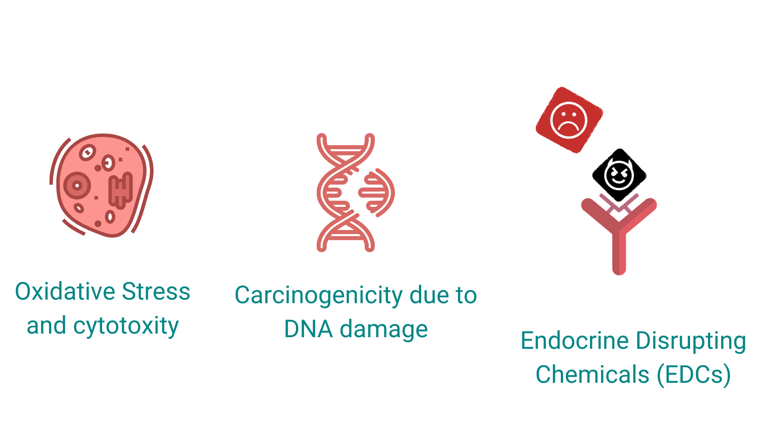



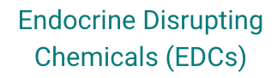
Appendix - How Microplastics can cause Breast Cancer
Hormone Receptor
Slide 4
Notes:
Now, we would be going on to talk about how microplastics can cause breast cancer.
Microplastics could cause oxidative stress by releasing oxidising chemicals (such as metals) adsorbed to their surface and reactive oxygen radicals. Oxidative stress can damage cells, proteins and DNA, which contributes to ageing.
As repeated cell death ensues, more cell division has to occur, and hence increasing the risk of dna mutation and cancer.
Microplastics also often contain a mixture of EDCs, which are endocrine disrupting chemicals. How EDCs work is by being shaped like the natural hormones, and attaching to the hormone receptor, and hence either blocking the natural hormone from being able to latch on to the receptor, or triggering the hormone receptor when it is not supposed to. Recent science has found that EDCs are associated with various diseases and conditions, such as hormonal cancers such as breast cancer, as the EDCs will induce adverse effects in the normal mammary development.

Slide 10

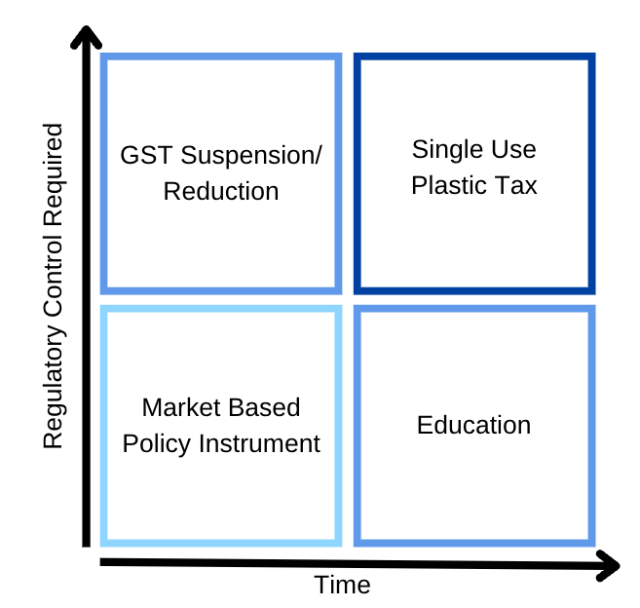
Appendix - Evaluation Matrix of Recommendations
Slide 6
Notes:
The chart above evaluates our recommendations based on the amount of regulatory control required for the implementation of the recommendation, as well as the amount of time required before the recommendation can be fully effective.
The tax based recommendations would require more regulatory effort, and perhaps receive backlash. The Single Use Plastic Tax recommendation policy would require time to be effective, as it targets microplastic production and it is often argued that tax is regressive in nature, thus careful consideration and calibration need to be taken into account.
The Market Based Policy Instrument and Education recommendations require less regulatory effort. The Market Based Policy Instrument recommendation would require less time to be effective as consumers would be incentivized by the money savings, and the education recommendation would require more time to be effective, as it requires the consumers to internalise the habits and be intrinsically motivated to practice habits that will prevent microplastics from entering their body.

Slide 11
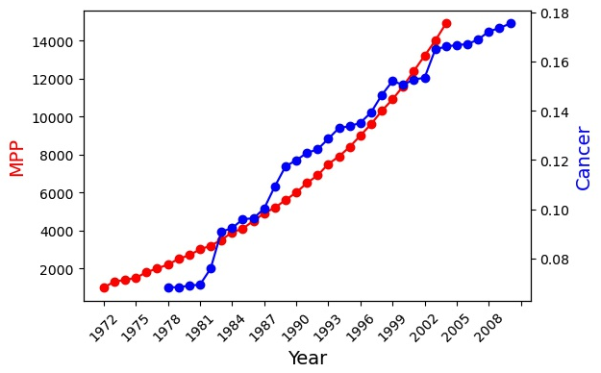
Appendix - MPP and Breast Cancer
Slide 9
Notes:
This slide depicts the trends for Breast Cancer Incidence Rates (%) as well as for Microplastic Emissions (Tonnes). This allows us to visualize the increment in both Microplastics emission and breast cancer incidence as time goes by. From this graph, we can easily tell that there is a positive correlation between the two variables.

Slide 12
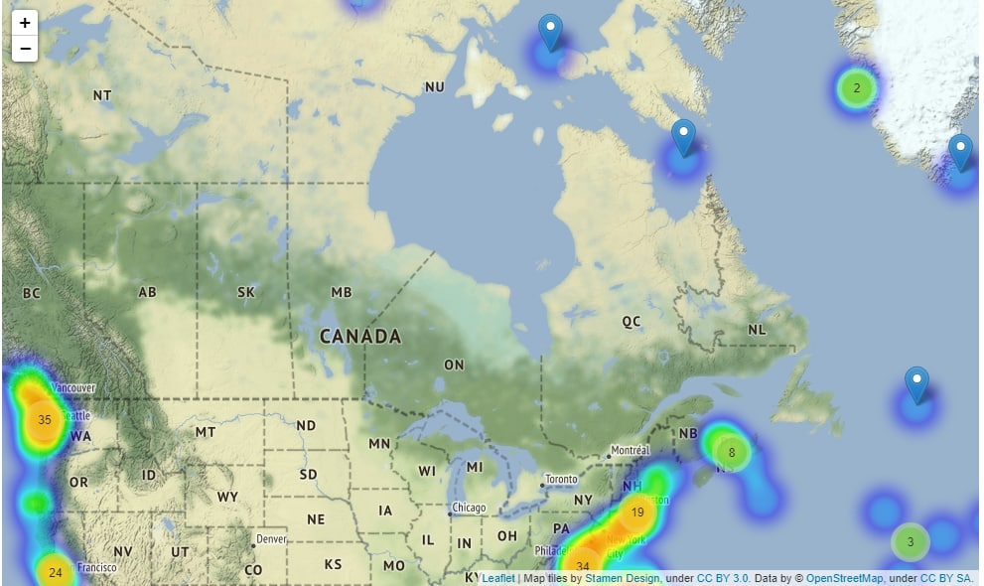
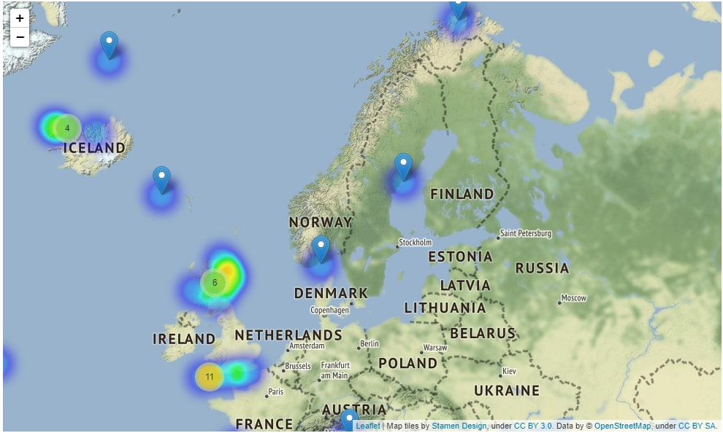
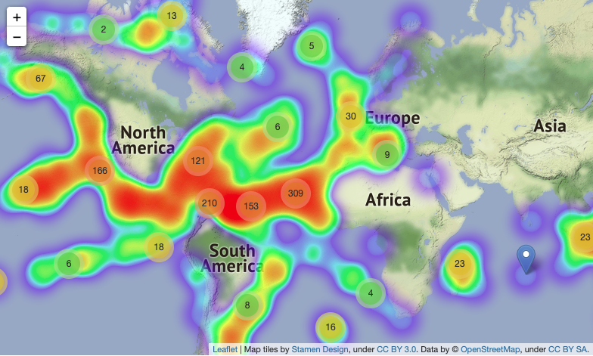
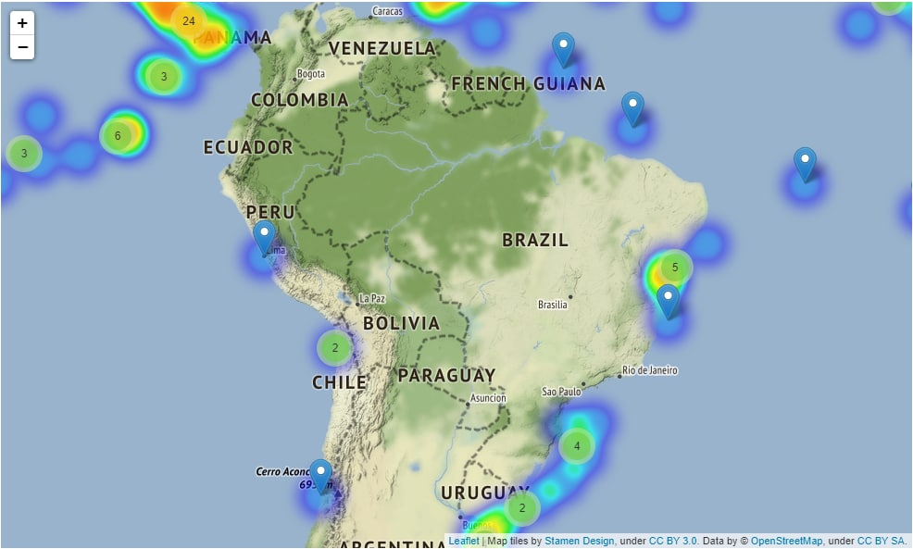
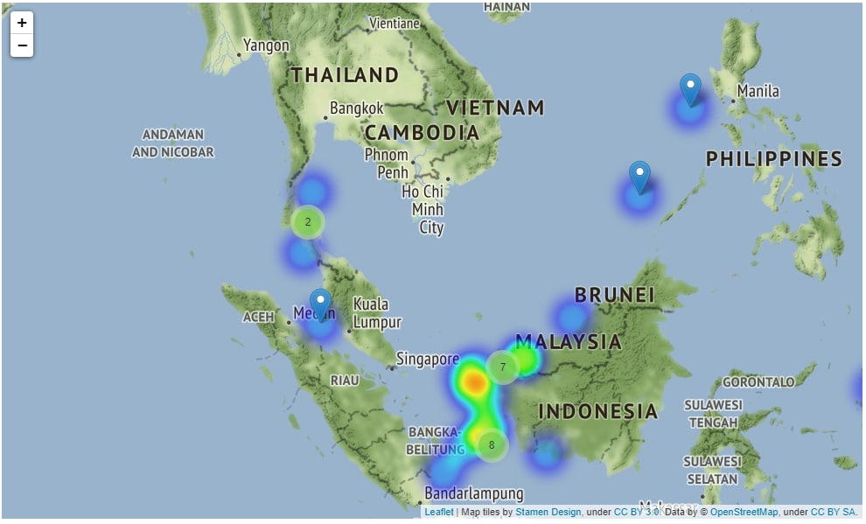
Appendix - Import from places with lesser MP
Slide 6
Notes:
One of our solutions include GST Suspension/Reduction for fish imports from regions with lesser microplastic pollution. From the heatmap generated from our dataset, we can identify the regions that have lesser microplastic pollution. In particular, this regions include Canada, Norway, Ecuador, Chile and Vietnam. As you can see from this heatmap, the main regions that have large microplastic pollutions tend to come from North America regions and also near Africa.
From these images, we can see that the regions mentioned previously have very little microplastic pollutants around their region and hence very little hotspots.

